Slide 1
Hiding Traffic Fingerprints
Technical Director - William Layton
Ruiyu Mao, Joseph Norman, Tram Pham, Marlon Schumacher, Alinta Wang

Slide 2
Agenda
Introduction
Goals and Approach
Progress
Experiments
Next Steps
Timeline
Q&A

Slide 3

Introduction
Website fingerprinting is the technique of enabling an eavesdropper to determine a user’s web activity.
It utilizes features of the user’s packet sequence in order to obtain information and knowledge of their personal lives.
  Even if traffic is encrypted, traffic trends for specific websites can reveal a user’s usage patterns
This gives vulnerability to any user’s privacy and underscores the gravity of building a stronger defense system.

Slide 4
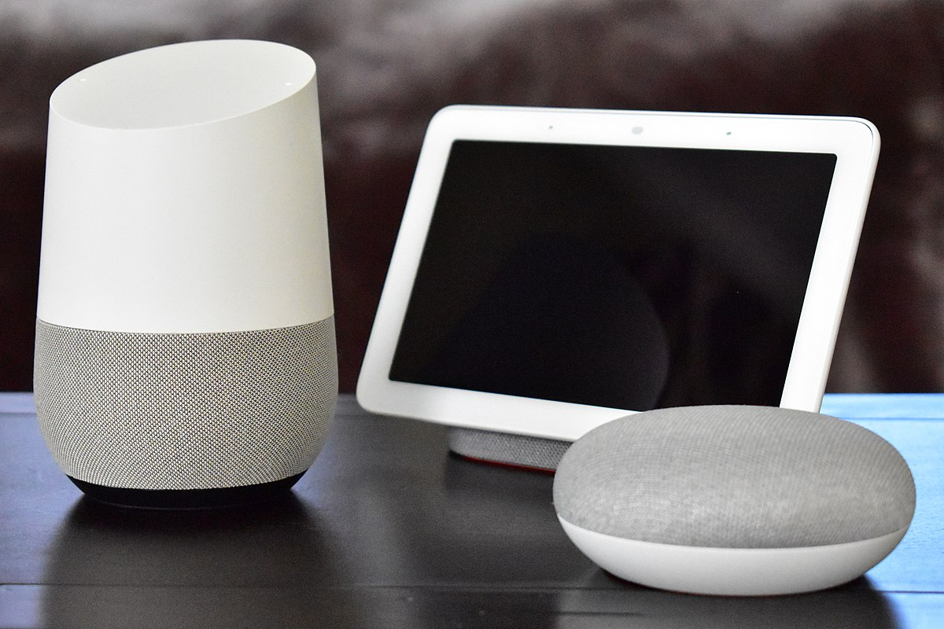
Motivation
Online services and communication is exponentially progressing
  Leads to rapidly growing concern of privacy
Attackers are able to gain sensitive information
  To what extent?
Contributing to ongoing research will establish better understanding of how dangerous traffic fingerprinting is

Slide 5
Goals
Gain a thorough understanding and quantification of the threat of traffic fingerprinting
Understand how much we need to do to protect against traffic fingerprinting
Provide insight into ways traffic fingerprinting can be done
Figure out potential ways to mitigate traffic fingerprinting

Slide 6

Team Approach
Research existing models of traffic fingerprinting
Examine models through experimentation and testing
Build and expand on the models by creating and testing variations
Conduct further experiments and analyze results

Slide 7
Current Progress
Shifted focus on creating experiments that build upon the attack/defense models described in the paper “WF-GAN: Fighting Back Against Website Fingerprinting Attack Using Adversarial Learning”
Established testing environment

Slide 8
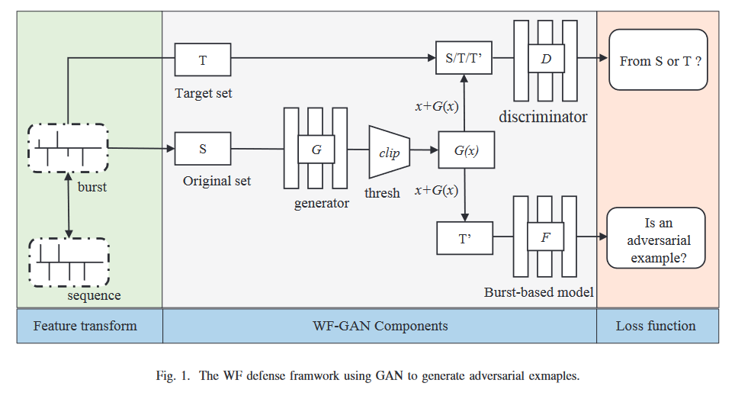
WF-GAN
Deep learning classifiers make traffic fingerprinting hard to combat
Solution: Website Fingerprinting Generative Adversarial Network (WF-GAN)

Slide 9
WF-GAN
WF-GAN obscures data from fingerprinting attacks and classifiers
  Converts data into I/O burst sequences
  Splits data into original and fake data and sends both to network
  Discriminator in network determines whether data can be sent as a normal packet
    Make it hard to tell real data from fake
  Generates adversarial examples
    Slightly altered version of original data to throw off classifiers
WF-GAN trained against the Deep Learning WF attack until WF-GAN’s data loss was minimized
After training, WF-GAN could successfully fool classifiers
  90% success rate for untargeted and targeted defense

Slide 10

Our Testing Environment
Virtual Machine
Set up Wireshark to read network traffic from VM
10 minutes of generic use on a website
  Twitch, Reddit, Youtube, Twitter, etc
Collect flow metrics
  MB/sec
  Inbound/Outbound
Notes:
Presenting - Joseph Norman

Slide 11
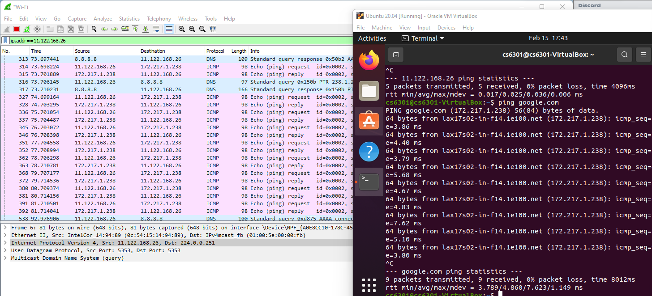
Our Testing Environment (continued)

Slide 12
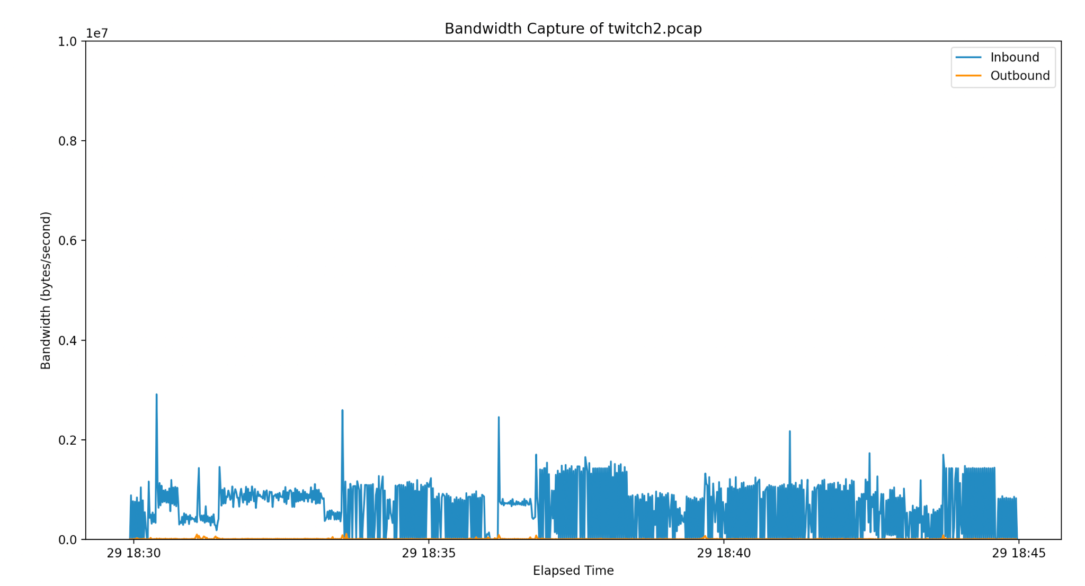
Web Traffic on Twitch
Notes:
Presenting - Joseph Norman

Slide 13
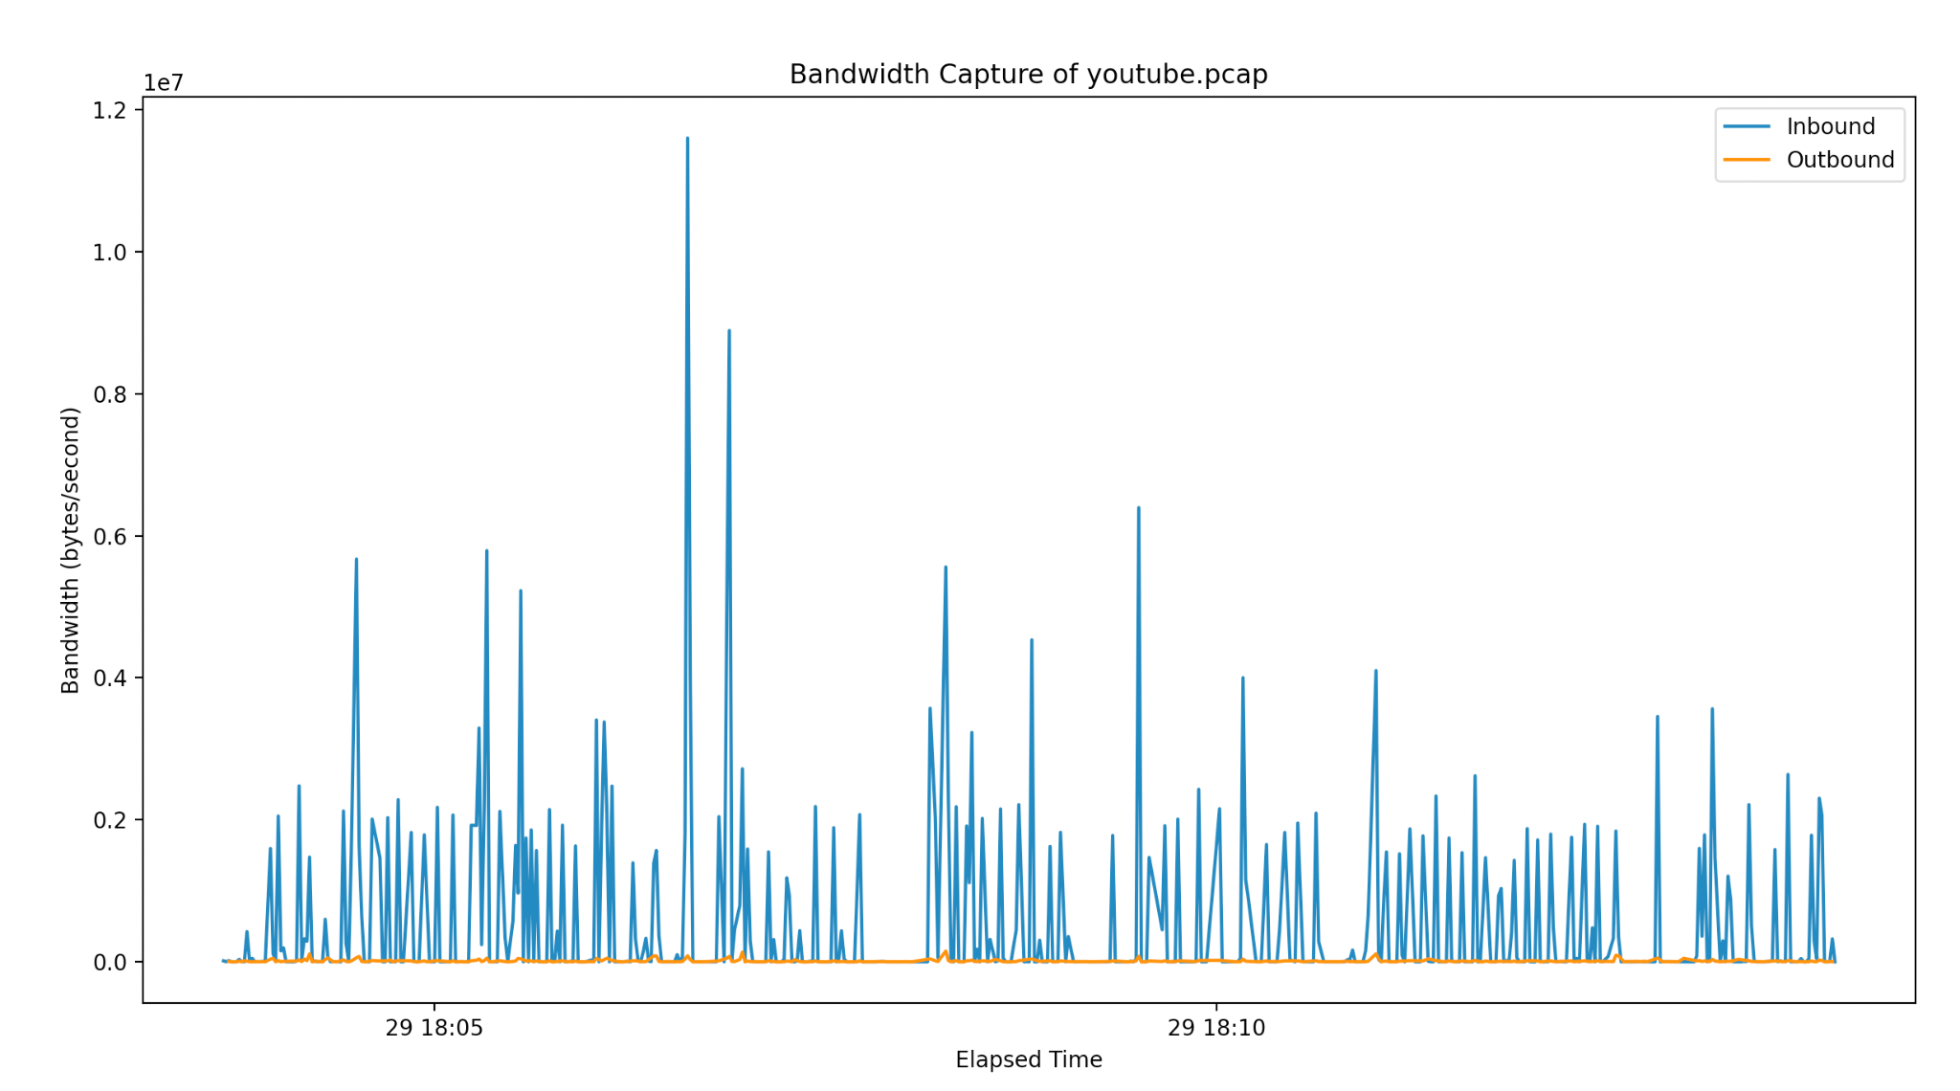
Web Traffic on YouTube

Slide 14
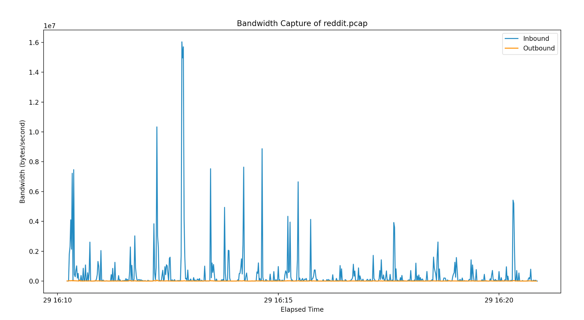
Web Traffic on Reddit

Slide 15
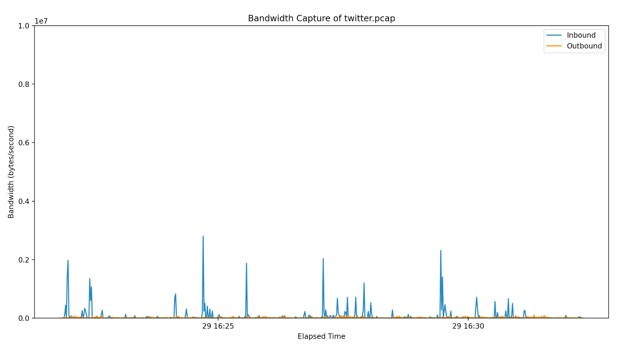
Web Traffic on Twitter

Slide 16

Website Fingerprinting Attack
Training the Deep Learning Web Fingerprinting Attack
Collecting sessions in PCAP files
Converting PCAPs to Pandas Dataframes
Aggregating packet sizes by inbound/outbound and timestamps
  Timestamps aggregated by sample rate (i.e. per second)
Repeatedly sample random 1 minute segments from the PCAP session
  Inputs
    Inbound 60 sampled MB/s
    Outbound 60 sampled MB/s
  Label: website the PCAP captured
Train Tensorflow NN over several epochs
Test NN with newly captured PCAP session

Slide 17
Future Plans
Randomly sample 1 minute intervals from our online sessions
Train a web fingerprinting attack with Deep Learning
Train a classifier to associate flow metrics with websites
Use an Adversarial Network to fool the classifier
Notes:
Presenting - Joseph Norman

Slide 18


Timeline
February 11
April 1
May 5
Research and explore topics
Midterm Report and Presentation
Final Report and Presentation
February 4
February 25
April 8
Submit Proposal
Setup environment and experiment
Continue research and experiments

Slide 19
Questions?
Notes:
Presenting - Joseph Norman

